Slide 1
Microsoft Power BI

Slide 2
Developer Deep Dive into Row Level Security
Ted Pattison
Principal Program Manager
Power BI Customer Advisory Team (PBICAT)

Slide 3
Welcome to Power BI Dev Camp
Power BI Dev Camp Portal - https://powerbidevcamp.net

Slide 4
Demo Files For This Session
https://github.com/PowerBiDevCamp/RowLevelSecurity

Slide 5
Agenda
Row Level Security (RLS) Fundamentals
Dynamic RLS Designs
Advanced RLS Design
Using RLS with App-Owns-Data Embedding
Filtering in RLS Roles with UserName and CustomData

Slide 6
What Is Row-level Security (RLS)
Security Scheme based on Named Roles
Roles are defined using Power BI Desktop
Each role is scoped to the dataset within a PBIX project
Role defined using one or more DAX expressions
DAX expressions restrict which rows are accessible

Slide 7
RLS Roles
Named filter sets
Each role defines 0 or more filters
When role contains multiple filters, filter restrictions ANDed together
When user is in multiple roles, role restrictions ORed together
RLS Design Patterns
Static RLS designs involve creating multiple roles
Dynamic RLS designs typically based on a single role
Best practice
Design RLS so that users are added to single role
Avoid designs where user needs to be added to multiple roles

Slide 8
Create Roles in Power BI Desktop

Slide 9
Testing using View As Roles in Power BI Desktop

Slide 10
Creating an Admin role to view all data

Slide 11
Creating RLS Rules using Table Filter DAX Expressions
Look for equality

Slide 12
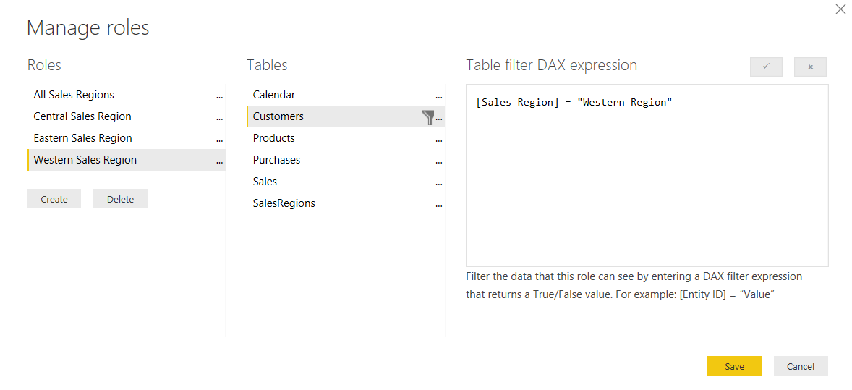
Configuring RLS in the Power BI Desktop

Slide 13
Configuring RLS in the Power BI Service
Configure role mappings
map members to dataset roles
Members can be user accounts or security groups
M365 Groups cannot be added to RLS role
Service principal cannot be added to RLS role

Slide 14
RLS Enforcement

Slide 15
GOTCHA - RLS Disabled for Users with Read/Write Access to Dataset
RLS enabled for users with read-only access to dataset
RLS disabled when user added in workspace role with edit permissions
When configuring access through workspace, user must be added a visitor
If possible, configure access through Power BI app where all users are read-only

Slide 16
Configuring Row-level Security

Slide 17
Agenda
Row Level Security (RLS) Fundamentals
Dynamic RLS Designs
Advanced RLS Design
Using RLS with App-Owns-Data Embedding
Filtering in RLS Roles with UserName and CustomData

Slide 18
Dynamic RLS
Design pattern for data-driven security
RLS set up to use login name of current user
Permission assignments are included as part of dataset
Implemented using bi-directional cross-filtering
data model extended with users table and permissions table

Slide 20
Dynamically Tracking the Current User
Sss
Filter user in RLS role using USERNAME() or USERPRINCIPALNAME()

Slide 21
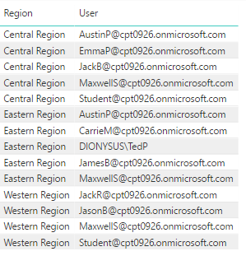
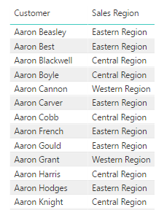
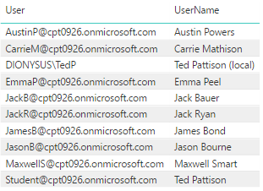
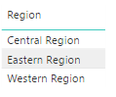
Dynamic RLS Table Filtering
UserPermissions
Customers
Users
Users

Slide 22
Relationships
Cardinality
One-to-many (1:*)
Many-to-one (*:1)
One-to-one (1:1)
Many-to-many (*:*)
Cross filter direction for one-to-many relationships
Must be set to either Single or Both
When set to Single, filter only propagates from one side to many side
When set to Both, filter is also propagated from many side to one side

Slide 23
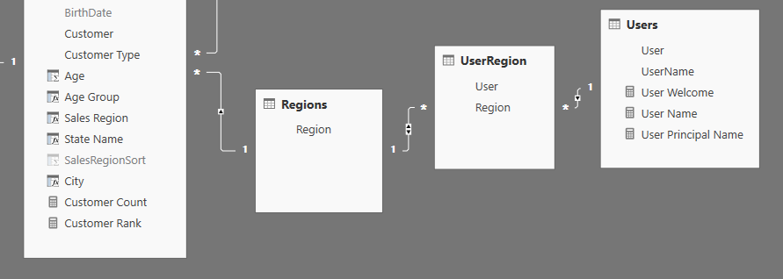
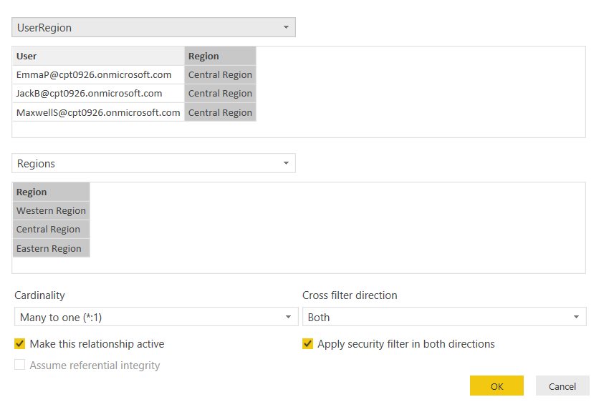
Configuring Cross-direction Filtering

Slide 24
Test Dynamic RLS in Power BI Desktop

Slide 25
Map All Users to Single RLS Role using AAD Group

Slide 26
Dynamic RLS Enforcement

Slide 27
Configuring Dynamic Row-level Security

Slide 28
Agenda
Row Level Security (RLS) Fundamentals
Dynamic RLS Designs
Advanced RLS Design
Using RLS with App-Owns-Data Embedding
Filtering in RLS Roles with UserName and CustomData

Slide 29
Multiple Roles and Limited Relationships
Model relationships are evaluated
Model relationships are classified as either regular or limited
Limited Relationship
1-to-many relationships
Relationship tables both in same site group
Limited Relationship
Many-to-many relationships
Relationship is cross site group

Slide 30
Troubleshoot RLS
Incorrect relationships exist between model tables
column mappings and/or filter directions.
Apply security filter in both directions isn't correctly set.
Tables contain no data.
Incorrect values are loaded into tables.
The user is mapped to multiple roles.
The model includes aggregation tables, and RLS rules don't consistently filter aggregations and details. For more information, see Use aggregations in Power BI Desktop (RLS for aggregations).

Slide 31
Avoid RLS If You Don’t Need It
For scenarios with small number of static roles
Go with separate Datasets instead
Create template PBIX file with parameters
Advantages
Better performance
Smaller datasets
Better isolation
Can address scenarios that don’t support RLS (publish to web)

Slide 32
Measure RLS impact
Measure performance impact of RLS filters using Performance Analyzer
determine report visual query durations when RLS isn't enforced
View as role

Slide 33
Design Partial RLS
Show % of total

Slide 34
Agenda
Row Level Security (RLS) Fundamentals
Dynamic RLS Designs
Advanced RLS Design
Using RLS with App-Owns-Data Embedding
Filtering in RLS Roles with UserName and CustomData

Slide 35
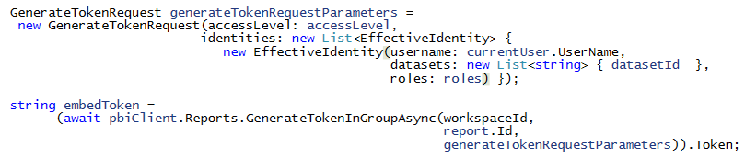
Embedding RLS-enabled Reports
Programming with EffectiveIdentity
RLS-enabled reports require role(s) for access
Embed tokens must be generated with 1 or more roles
Roles added to embed token using EffectiveIdentity

Slide 36
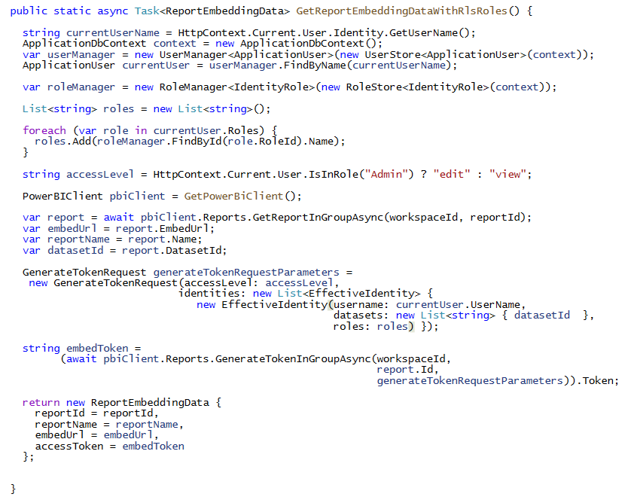
Programming with EffectiveIdentity

Slide 37
Agenda
Row Level Security (RLS) Fundamentals
Dynamic RLS Designs
Advanced RLS Design
Using RLS with App-Owns-Data Embedding
Filtering in RLS Roles with UserName and CustomData

Slide 38
50 rows
375,000 rows
5,000,000 rows

Slide 39
Agenda
Row Level Security (RLS) Fundamentals
Dynamic RLS Designs
Advanced RLS Design
Using RLS with App-Owns-Data Embedding
Filtering in RLS Roles with UserName and CustomData

Slide 40
Microsoft Power BI
Questions?

